Slide 1
Project Design Review
RC Plane

Slide 2
Project Goals and Specifications
Design an RC airplane which can:
Achieve sustained flight for 60+ seconds
Perform turns without crashing
Withstand mild crashes without sustaining significant damage
Stretch goals:
Land airplane successfully [belly down, no damage]
Take in-flight measurements and perform Arduino-automated tasks
e.g. Automated turn, level flight, maintain speed, geofencing

Slide 3
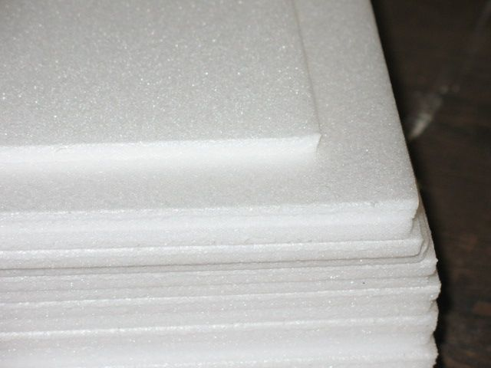
Design Choice: Structural Material
Originally wanted to 3D print the plane parts:
Pros: Greater control over shape, easy to re-make if it breaks
Cons: Brittle, heavy, would need to print in pieces and assemble
Instead we chose foam (model plane grade)
Pros: Lightweight, ductile, yet rigid to wind stress. Faster to machine.
Cons: Must buy material in bulk, more labor intensive assembly of wings, fuselage, etc.

Slide 4
Design Choice: Push vs Pull Propeller
Pull Propeller: Higher maneuverability, lower stability
Push Propeller: Higher stability, lower maneuverability, restricts options for stabilizer positions and servo-pushrod-rudder/elevator setups. Also gets in the way of push rods.
We decided to use a pull propeller.

Slide 5
Design Choice: Removable vs Attached Wings
Removable (Top Mounted) Wings:
Strapped on via rubber bands attached to dowels
Dowel supports prevent bands from damaging foam
One continuous part
Provides easy access to electronics in fuselage
Reduces risk of wing damage during crash
Center of gravity moved upward
Can easily swap out different wing shapes
Fuselage-Attached (Fixed) Wings
More rigid/stiff during aerobatic maneuvers which produce high wing stress
Lowers center of gravity
Higher risk of irreversible damage during crash
We decided to use removable, top-mounted wings

Slide 6
Design Choice: Sensor Suite
We want (air)speed, altitude, and some sort of inertial measurement unit (IMU) for semi autonomous functions
For the IMU, only choice really a gyroscope/accelerometer board
For airspeed and altitude, two options
Barometer (altitude) and Pitot Tube (airspeed)
Pros: Get altitude within 0.3m, get accurate airspeed
Cons: Two different sensors increase wiring complexity and cost, barometer needs calibration before flight
GPS
Pros: Can get altitude, groundspeed, position, cheaper, less complex wiring
Cons: Get ground speed instead of airspeed (less useful for stall detection), altitude less accurate than barometer, needs to connect to GPS satellites before each flight
We chose GPS

Slide 7
Design Choice: Landing Gear
Landing Gears:
Take off from flat runway, get up to speed using propeller
Let back of fuselage drag on the ground
Landing requires a flat surface, may be more difficult
No landing gear:
Hold plane in midair until propeller is up to speed, then toss it to take off
Can land either by catching the plane (grabbing the fuselage), or by skidding along a flat surface
Easier to implement
We chose not to add landing gear, for now. Should be easy to add later, if needed.

Slide 8
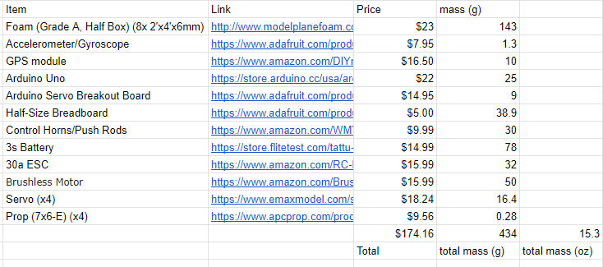
Materials/Mass List
Notes:
Need to get pricing from shop on transmitter/receiver pair, otherwise final. Foam mass based on solidworks.

Slide 9
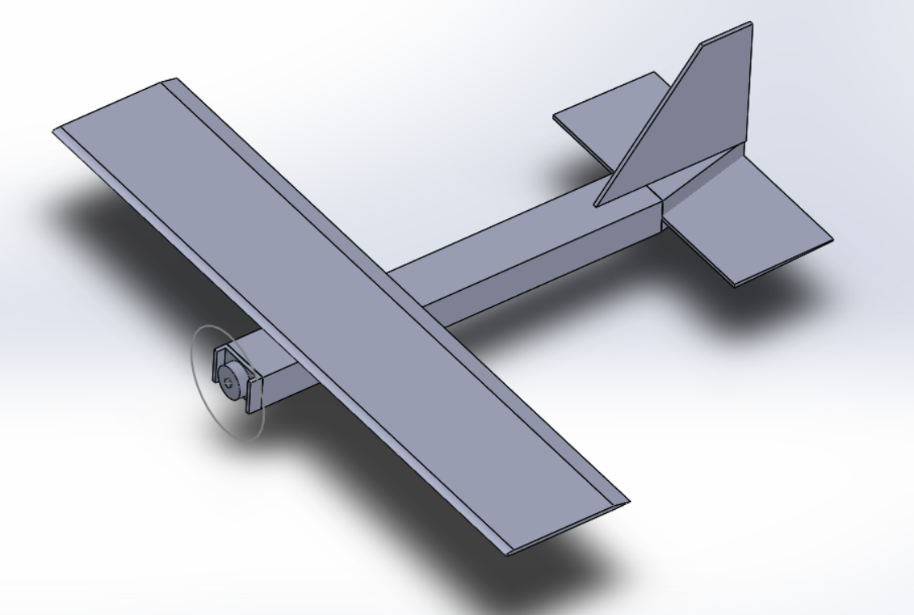
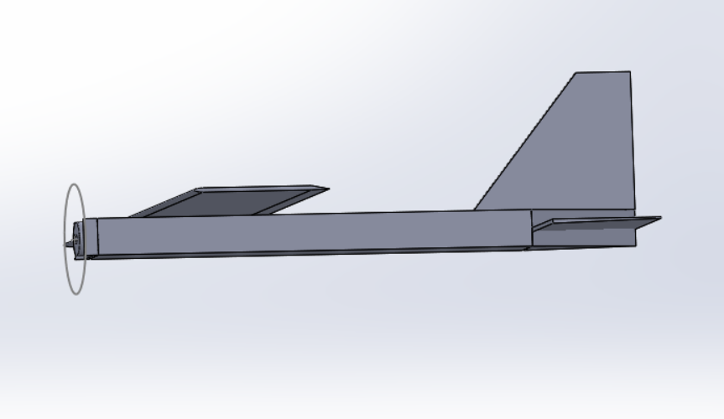
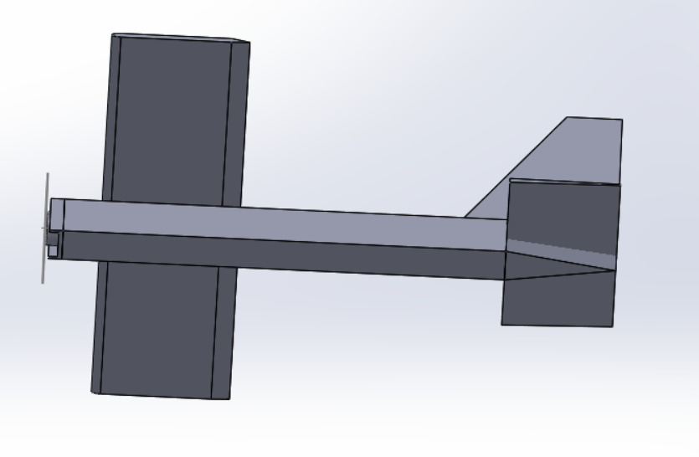
3D Solidworks Model

